Slide 1


Dept. of Computer Science & Engineering.
Assignment 3
JavaScript
PLD
Prepared By
Prof. A. R. Uttarkar
Assistant Professor
CSE Department, MIT SOE

Slide 2
JavaScript- Outline
Overview of JavaScript
using JS in an HTML (Embedded, External),
Data types,
Control Structures,
Arrays,
Functions
Objects
Scopes

Slide 3
Overview of JavaScript,
JavaScript is one of the 3 languages all web developers must
learn:
1. HTML to define the content of web pages
2. CSS to specify the layout of web pages
3. JavaScript to program the behavior of web pages
JavaScript is a very powerful client-side scripting language.
Javascript is a dynamic computer programming language.
•

Slide 4
JavaScript
JavaScript is a front-end scripting language developed by Netscape for dynamic content
Lightweight, but with limited capabilities
Can be used as object-oriented language
Client-side technology
Embedded in your HTML page
Interpreted by the Web browser
Simple and flexible
Powerful to manipulate the DOM

Slide 5
JavaScript Advantages
JavaScript allows interactivity such as:
Implementing form validation
React to user actions, e.g. handle keys
Changing an image on moving mouse over it
Sections of a page appearing and disappearing
Content loading and changing dynamically
Performing complex calculations
Custom HTML controls, e.g. scrollable table
Implementing AJAX functionality

Slide 6
What Can JavaScript Do?
Can handle events
Can read and write HTML elements
Can validate form data
Can access / modify browser cookies
Can detect the user’s browser and OS
Can be used as object-oriented language
Can handle exceptions
Can perform asynchronous server calls (AJAX)

Slide 7
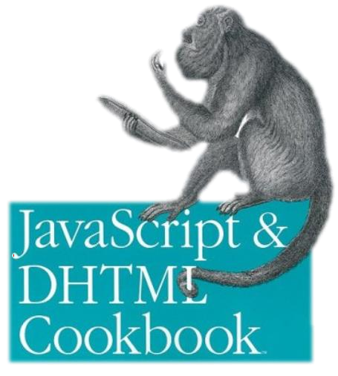

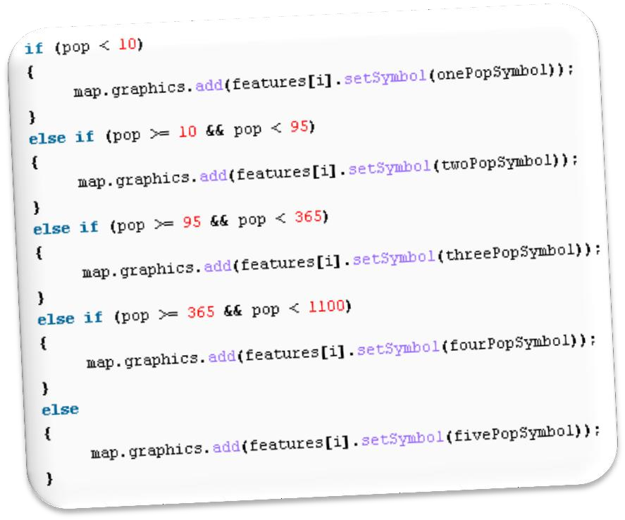


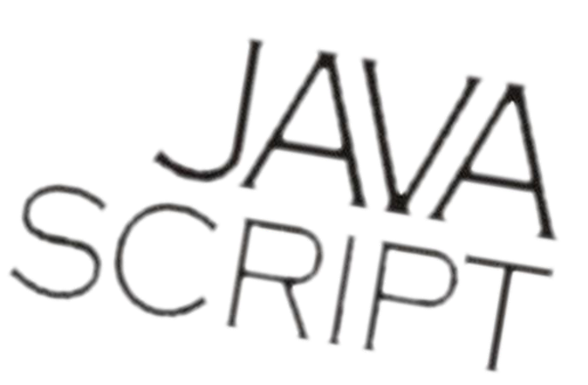
The JavaScript
Syntax

Slide 8
JavaScript Syntax
JavaScript can be implemented using <script>... </script> HTML tags in a web page.
Place the <script> tags, within the <head> tags.
Syntax:
<script language="javascript" type="text/javascript">
JavaScript code
</script>

Slide 9
JavaScript Syntax
Example:
<html>
<body>
<script language="javascript" type="text/javascript">
<!--
document.write("Hello World!")
//-->
</script>
</body>
</html>
The comment ends with a "//-->". Here "//" signifies a comment in JavaScript
Output
Hello World!

Slide 10
JavaScript Editor and Extension
Use Notepad to write the code
Save the document using .html (if embedded JavaScript)
Save document with .js (if external JavaScript)
Run the code in brower

Slide 11
JavaScript Syntax
The JavaScript syntax is similar to C# and Java
Operators (+, *, =, !=, &&, ++, …)
Variables (typeless)
Conditional statements (if, else)
Loops (for, while)
Arrays (my_array[]) and associative arrays (my_array['abc'])
Functions (can return value)
Function variables (like the C# delegates)
12

Slide 12
Enabling JavaScript in Browsers
JavaScript in Firefox
Open a new tab → type about: config in the address bar.
Then you will find the warning dialog.
Select I’ll be careful, I promise!
Then you will find the list of configure options in the browser.
In the search bar, type javascript.enabled.
There you will find the option to enable or disable javascript by right-clicking on the value of that option → select toggle.

Slide 13
JavaScript - Placement in HTML File
There is a flexibility given to include JavaScript code anywhere
in an HTML document.
However the most preferred ways to include JavaScript in an HTML file are as follows −
Script in <head>...</head> section.
Script in <body>...</body> section.
Script in <body>...</body> and <head>...</head> sections.
Script in an external file and then include in
<head>...</head> section.

Slide 14
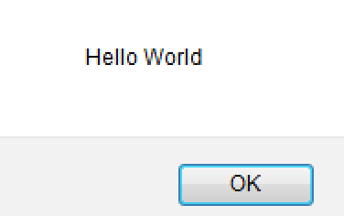
JavaScript in <head>...</head> section
<html>
<head>
<script type="text/javascript">
<!-- function sayHello()
{ alert("Hello World") }
//--> </script>
</head>
<body>
<input type="button" onclick="sayHello()" value="Say Hello" />
</body>
</html>
This code will produce the following results −

Slide 15
JavaScript in <body>...</body> section
<html>
<head> </head>
<body>
<script type="text/javascript">
<!--
document.write("Hello World")
//-->
</script>
<p>This is web page body </p>
</body>
</html>
This code will produce the following results −
Hello World
This is web page body

Slide 16
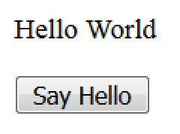
JavaScript in <body> and <head>
<html>
<head>
<script type="text/javascript">
<!-- function sayHello()
{ alert("Hello World") } //-->
</script>
</head>
<body>
<script type="text/javascript">
<!-- document.write("Hello World") //-->
</script>
<input type="button" onclick="sayHello()" value="Say Hello" />
</body> </html>
This code will produce the following result −

Slide 17
JavaScript in External File
HTML File
<html>
<head>
<script type="text/javascript" src="filename.js" >
</script>
</head>
<body> ....... </body>
</html>
JavaScript File – filename.js
function sayHello()
{ alert("Hello World") }

Slide 18
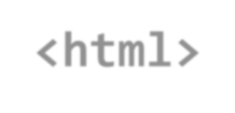
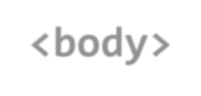
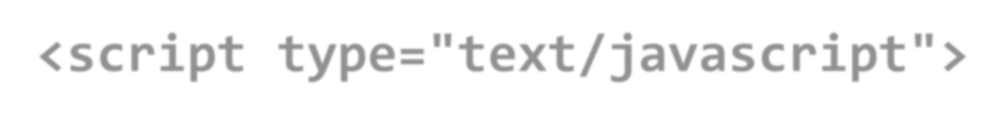
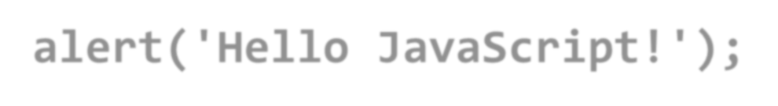
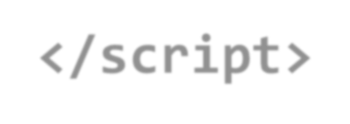
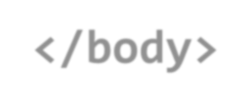
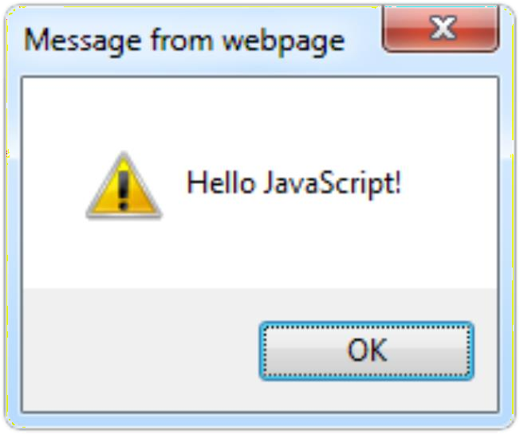

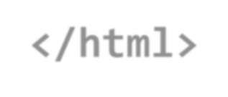
The First Script
first-script.html
<html>
<body>
<script type="text/javascript"> alert('Hello JavaScript!');
</script>
</body>
</html>
20

Slide 19
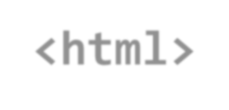


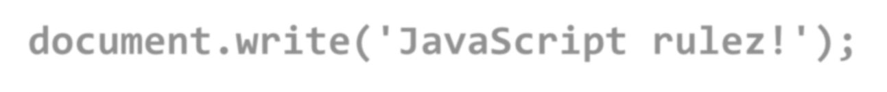
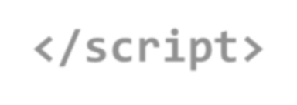
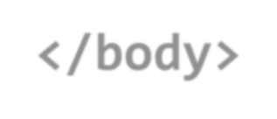
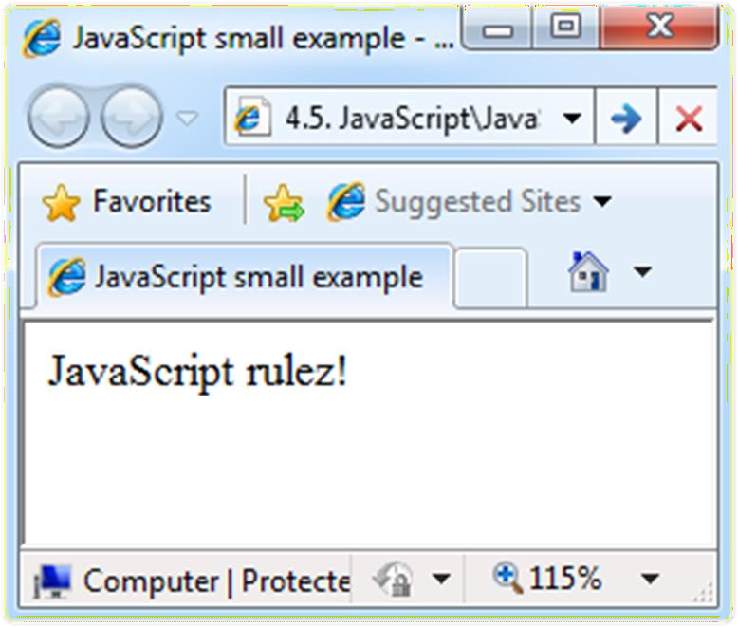

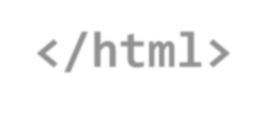
Another Small Example
small-example.html
<html>
<body>
<script type="text/javascript"> document.write('JavaScript rulez!');
</script>
</body>
</html>
21

Slide 20





Using JavaScript Code
The JavaScript code can be placed in:
<script> tag in the head
<script> tag in the body – not recommended
External files, linked via <script> tag the head
Files usually have .js extension
Highly recommended
The .js files get cached by the browser
<script src="scripts.js" type="text/javscript">
<!– code placed here will not be executed! -->
</script>
22

Slide 21
JavaScript – When is Executed?
JavaScript code is executed during the page loading or when the browser fires an event
All statements are executed at page loading
Some statements just define functions that can be called later
Function calls or code can be attached as "event handlers" via tag attributes
Executed when the event is fired by the browser
23
<img src="logo.gif" onclick="alert('clicked!')" />

Slide 22

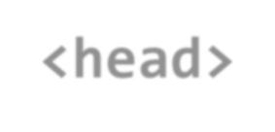

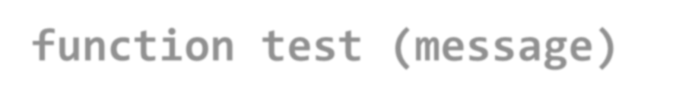
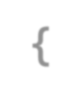
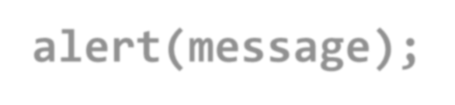
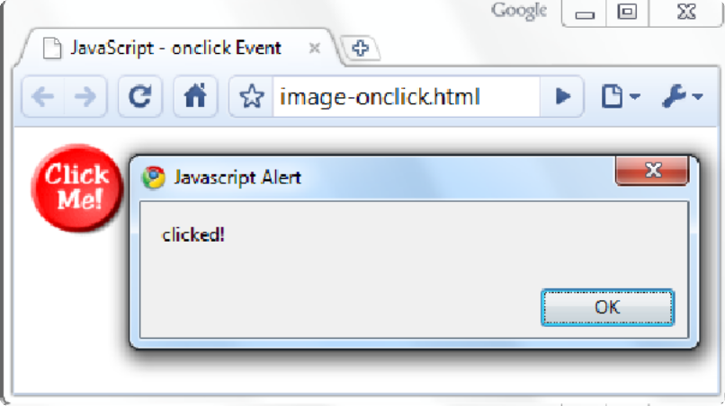
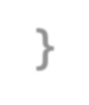

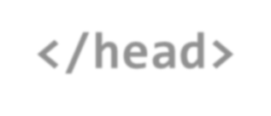

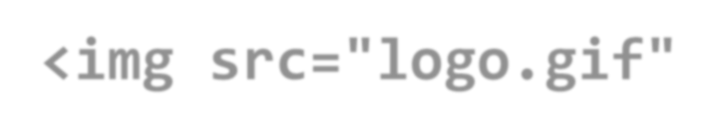



Calling a JavaScript Function from Event Handler – Example
<html>
<head>
<script type="text/javascript">
function test (message)
{
alert(message);
}
</script>
</head>
image-onclick.html
24
<body>
<img src="logo.gif" onclick="test('clicked!')" />
</body>
</html>

Slide 23



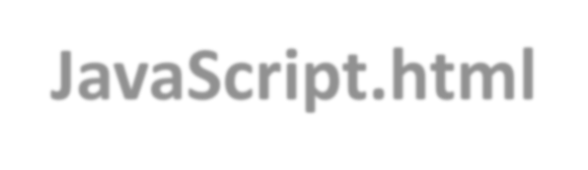
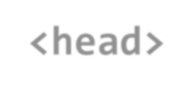
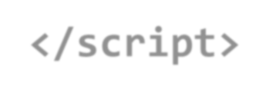


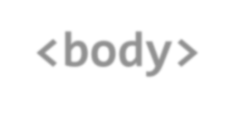
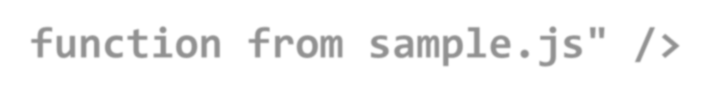
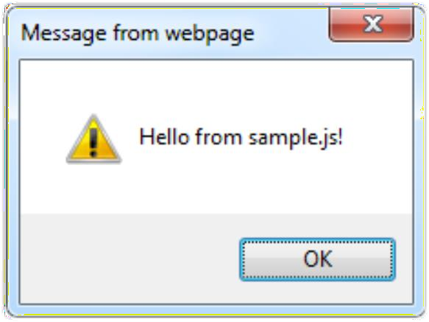
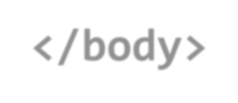

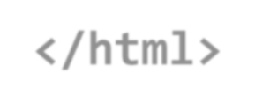
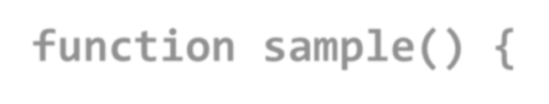
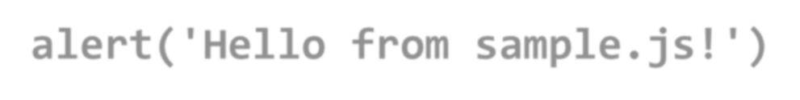
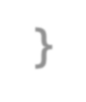

Using External Script Files
Using external script files:
<html>
<head>
external-JavaScript.html
<script src="sample.js" type="text/javascript">
</script>
</head>
<body>
The <script> tag is always empty.
25
<button onclick="sample()" value="Call JavaScript function from sample.js" />
</body>
</html>
External JavaScript file:
function sample() {
alert('Hello from sample.js!')
}
sample.js

Slide 24
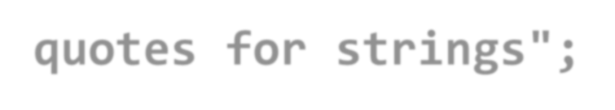
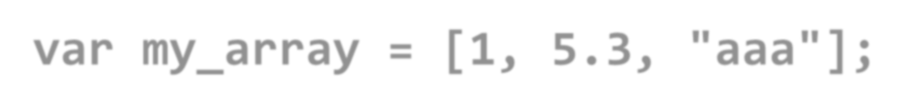
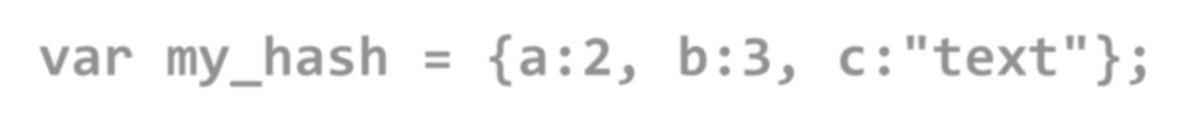
Data Types
JavaScript data types:
Numbers (integer, floating-point)
Boolean (true / false)
String type – string of characters
var myName = "You can use both single or double quotes for strings";
Arrays
26
var my_array = [1, 5.3, "aaa"];
Associative arrays (hash tables)
var my_hash = {a:2, b:3, c:"text"};

Slide 25
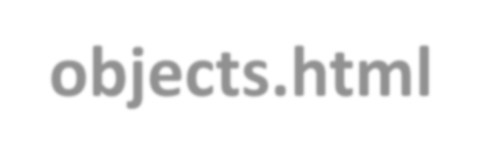
Everything is Object
Every variable can be considered as object
For example strings and arrays have member functions:
objects.html
var test = "some string"; alert(test[7]); // shows letter 'r'
alert(test.charAt(5)); // shows letter 's' alert("test".charAt(1)); //shows letter 'e' alert("test".substring(1,3)); //shows 'es'
27
var arr = [1,3,4];
alert (arr.length); // shows 3 arr.push(7); // appends 7 to end of array alert (arr[3]); // shows 7

Slide 26
String Operations
The + operator joins strings
string1 = "fat ";
string2 = "cats";
alert(string1 + string2);
// fat cats
28
What is "9" + 9?
alert("9" + 9);
// 99
Converting string to number:
alert(parseInt("9") + 9);
// 18

Slide 27
Arrays Operations and Properties
Declaring new empty array:
var arr = new Array();
Declaring an array holding few elements:
var arr = [1, 2, 3, 4, 5];
29
Appending an element / getting the last element:
arr.push(3);
var element = arr.pop();
Reading the number of elements (array length):
arr.length;
Finding element's index in the array:
arr.indexOf(1);

Slide 28
Standard Popup Boxes
Alert box with text and [OK] button
Just a message shown in a dialog box:
alert("Some text here");
30
Confirmation box
Contains text, [OK] button and [Cancel] button:
confirm("Are you sure?");
Prompt box
Contains text, input field with default value:
prompt ("enter amount", 10);

Slide 29
JavaScript Variables
<script type="text/javascript">
<!--
var name = "Amit";
var money;
money = 2000.50;
//-->
</script>

Slide 30
Sum of Numbers – Example
sum-of-numbers.html
<html>
<head>
<title>JavaScript Demo</title>
<script type="text/javascript">
function calcSum() { value1 =
parseInt(document.mainForm.textBox1.value); value2 =
parseInt(document.mainForm.textBox2.value); sum = value1 + value2; document.mainForm.textBoxSum.value = sum;
}
</script>
</head>
32

Slide 31
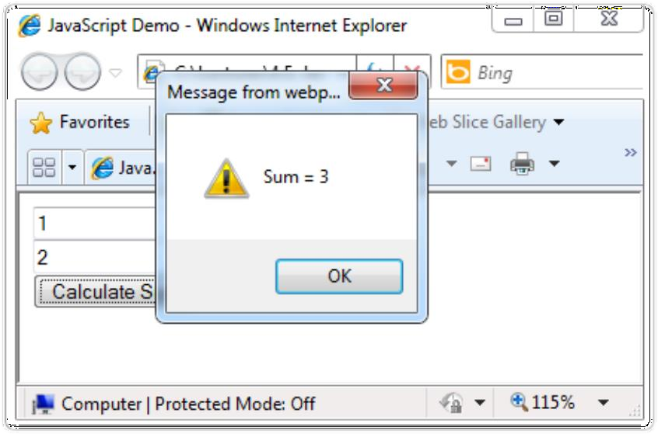

Sum of Numbers – Example (2)
sum-of-numbers.html (cont.)
<body>
<form name="mainForm">
<input type="text" name="textBox1" /> <br/>
<input type="text" name="textBox2" /> <br/>
<input type="button" value="Process"
onclick="javascript: calcSum()" />
<input type="text" name="textBoxSum" readonly="readonly"/>
</form>
</body>
</html>
33

Slide 32
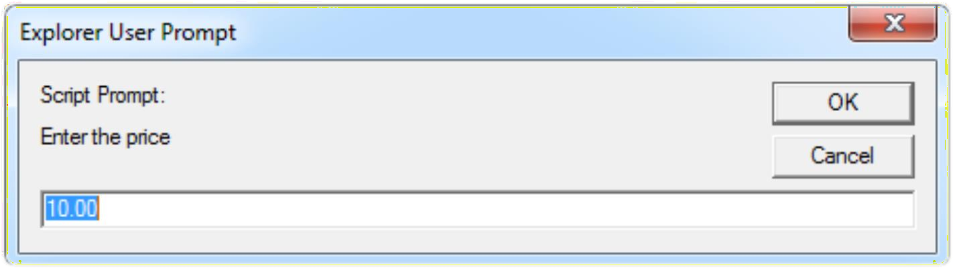

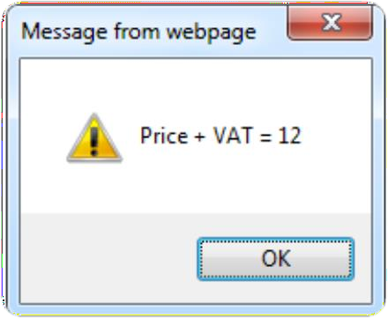

JavaScript Prompt – Example
prompt.html
price = prompt("Enter the price", "10.00"); alert('Price + VAT = ' + price * 1.2);
34

Slide 33
JavaScript - Operators
Arithmetic Operators
Comparison Operators
Logical (or Relational) Operators
Assignment Operators
Conditional (or ternary) Operators

Slide 34
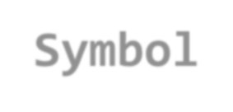
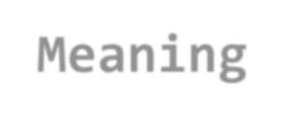





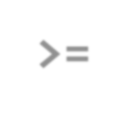


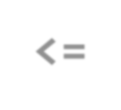
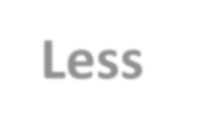






Conditional Statement (if)
unitPrice = 1.30;
if (quantity > 100) {
unitPrice = 1.20;
}
36
Symbol
Meaning
>
Greater than
<
Less than
>=
Greater than or equal to
<=
Less than or equal to
==
Equal
!=
Not equal

Slide 35













Switch Statement
The switch statement works like in C#:
switch (variable) { case 1:
// do something break;
case 'a':
// do something else
break; case 3.14:
// another code break;
default:
switch-statements.html
37
// something completely different
}

Slide 36

Switch case Example

Slide 37













Loops
Like in C#
for loop
while loop
do … while loop
var counter;
for (counter=0; counter<4; counter++)
{
alert(counter);
}
while (counter < 5)
{
alert(++counter);
}
39
loops.html

Slide 38
While-loop Example
<html>
<body>
<script type="text/javascript">
<!-- var count = 0;
document.write("Starting Loop ");
while (count < 10){
document.write("Current Count : " + count + "<br />"); count++; }
document.write("Loop stopped!");
//--> </script>
<p>Set the variable to different value and then try...</p>
</body> </html>

Slide 39



















Functions
Code structure – splitting code into parts
Data comes in, processed, result returned
Parameters come in here.
41
function average(a, b, c)
{
var total; total = a+b+c; return total/3;
}
Declaring variables is optional. Type is never declared.
Value returned
here.

Slide 40
Function Arguments & Return Value
Functions are not required to return a value
When calling function it is not obligatory to specify all of its arguments
The function has access to all the arguments passed via arguments array
function sum() { var sum = 0;
for (var i = 0; i < arguments.length; i ++) sum += parseInt(arguments[i]);
return sum;
}
alert(sum(1, 2, 4)
functions-demo.html
42

Slide 41
JavaScript Function Syntax
function name(parameter1, parameter2, parameter3) {
code to be executed
}
var x = myFunction(4, 3); // Function is called, return value will end up in x
function myFunction(a, b) {
return a * b; and b
}
// Function returns the product of a

Slide 42
Assignment Title
Write a Java Script code to take inputs from user and display inputs in following pattern
Hello………………Welcome to World of Javascript
Welcome to MIT ADT University, Pune

Slide 43
Students Tasks
Write a Javascript for Inputting Given details
Make Use of Appreciate HTML form and Tags
Make use of CSS if requires
Show output as per requirement in assignment title

Slide 44
THANK YOU

